Slide 1
5G device-to-device communication

Slide 2
Introduction
5G is expected to play an important role in the development of smart city applications
Device-to-device (D2D) is a radio communication technology
D2D allows devices to directly exchange data without the need for base stations or access points

Slide 3
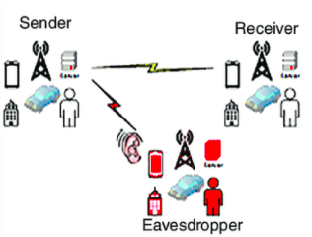
Eavesdropping in D2D
Eavesdropping involves an intruder listening to an exchange of information
Eavesdropping: a source node, a destination node, and an eavesdropping node
Eavesdroppers can be seen as active or passive
One of the most important protections against it is cryptography

Slide 4
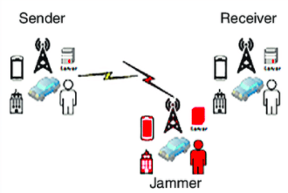
Jamming in D2D
Jamming is the malicious insertion of noise or signals into a channel in order to prevent the channel’s use
One 5G property that mitigates jamming is its wide range of frequency use
An anti-jamming protocol for cognitive radio networks is proposed in 2016

Slide 5
Injecting attack in D2D
In the injecting attack, data is not just eavesdropped, and channel use is not just interrupted, but data is actually maliciously changed
In 2016 was discussed three key exchange protocols. Each protocol involves two users, a base station, two channels, a public channel and an encrypted, dedicated channel

Slide 6
Multipath routing and security
Security in a D2D network involves transmission of keys and other sensitive data.
Faisal and Mathkoor discuss a protocol for using multipath data transmission to improve security
For route discovery they use a secure multipath algorithm called SecMR, which “discovers the complete set of the existing node-disjoint and non-cyclic paths between a source and a destination node”

Slide 7
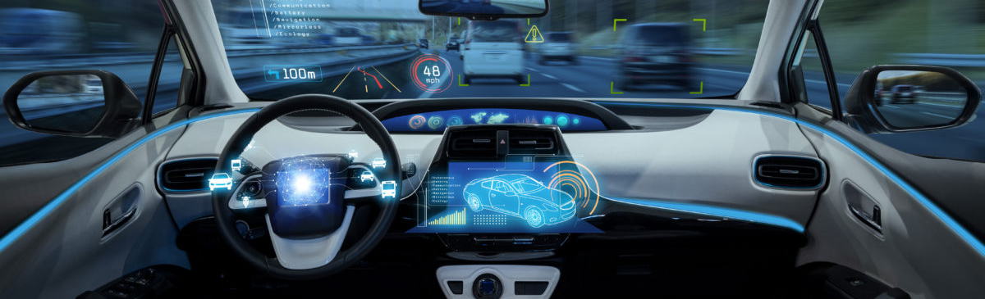
Device-to-Device applications
A primary application for this technology is the use of vehicle-to-vehicle (V2V) communication to facilitate self-driving cars and collision avoidance messages
Local exchange of information by proximity
5G wireless systems are expected to connect various “smart” objects within Smart Homes and Smart Cities as well as to monitor information from the surrounding environment

Slide 8
Thank you!

Slide 9
References
https://appliednetsci.springeropen.com/articles/10.1007/s41109-019-0220-6#Sec2
https://spectrum.ieee.org/applications-of-devicetodevice-communication-in-5g-networks
https://www.cambridge.org/core/books/abs/5g-mobile-and-wireless-communications-technology/devicetodevice-d2d-communications/5F1D2981046D973096993A07BBC53270
https://ieeeaccess.ieee.org/closed-special-sections/d2d-communications-security-issues-and-resource-allocation/
https://www.cambridge.org/core/books/abs/5g-mobile-and-wireless-communications-technology/devicetodevice-d2d-communications/5F1D2981046D973096993A07BBC53270
https://www.researchgate.net/figure/Attack-in-5G-mobile-networks-a-eavesdropping-b-jammer-c-DDoS-and-d-MITM_fig3_341436014

